Slide 1

Final Portfolio
Matt Ryder
Applied Data Science
Matthew.ryder@syr.edu
SUID#884895956

Slide 2
My Projects
Hearthstone Battlegrounds Database
Automating Loan Eligibility
Heart Disease Prediction
Spotify Song Prediction

Slide 3
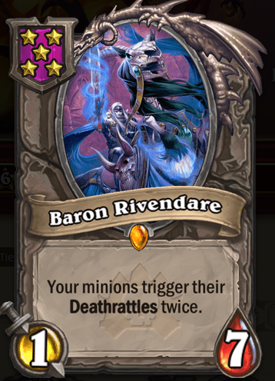
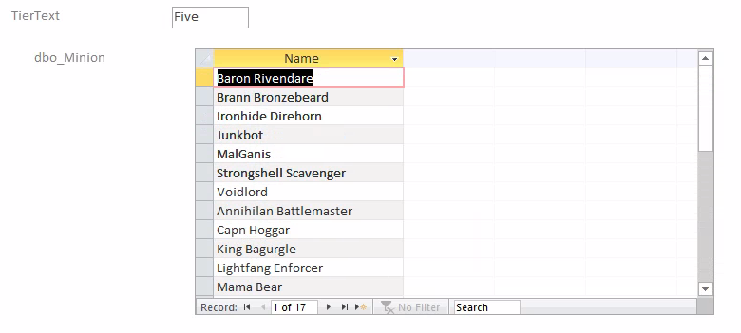
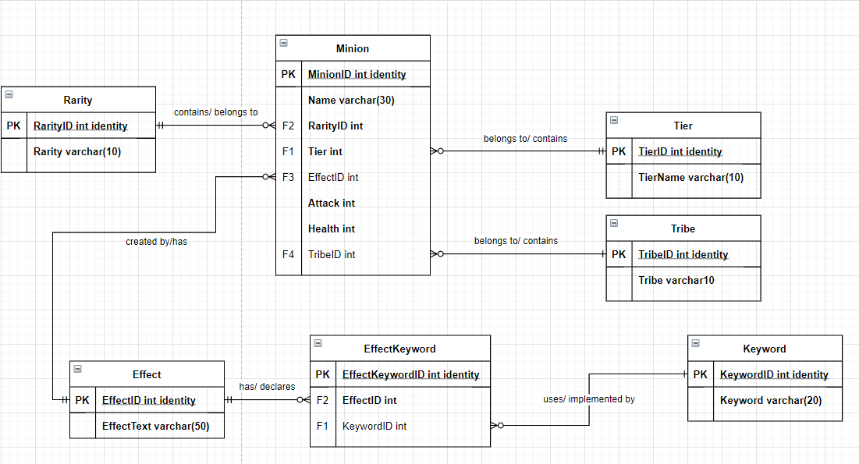
Hearthstone Battlegrounds Database
First iSchool Project
Data from Hearthstone
Used SQL Server and Microsoft Access
Normalized Database Model

Slide 4
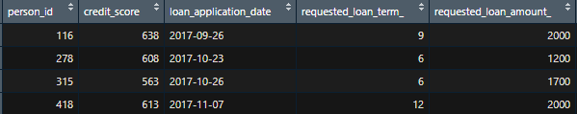
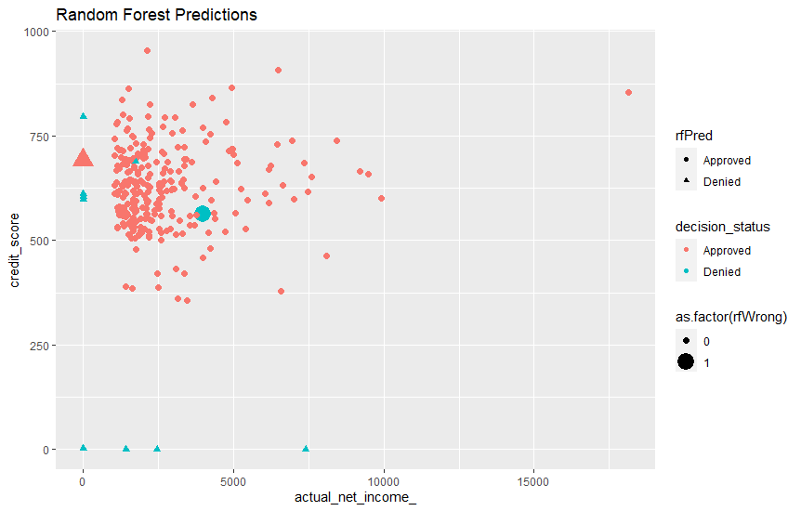
Automating Loan Eligibility
Build a prediction model for loan approval
Used bank applicant data
Used R Studio
Chose Random Forest Model

Slide 5
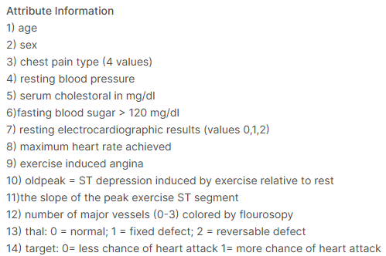
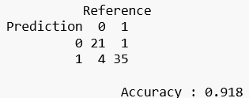
Heart Disease Prediction
Based upon previous project I had worked on
Using patient data from Kaggle
Used R Studio
Chose Random Forest Model

Slide 6
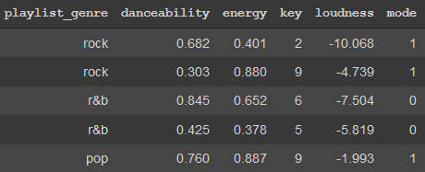
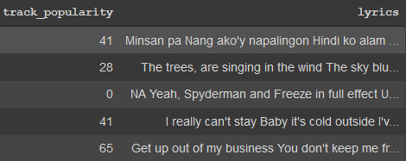
Spotify Song Prediction
Use techniques from multiple courses
Using data from Kaggle
Using Google Colab
Have a text and feature based model

Slide 7

Matt Ryder: mryder@syr.edu https://github.com/mattryder97/Syracuse-Final-Portfolio

